Slide 1
Pollution Levels Predictor--DAML
By Ashir Raza

Slide 2
Overview of Training Data
9 Features
Date-time: numerical data → can be converted to more useful categorical features
Degrees Celsius: numerical data
Relative/Absolute Humidity: numerical data
5 Sensor Readings: numerical data
3 Targets
Target C02/Benzene/NOx levels: numerical data

Slide 3
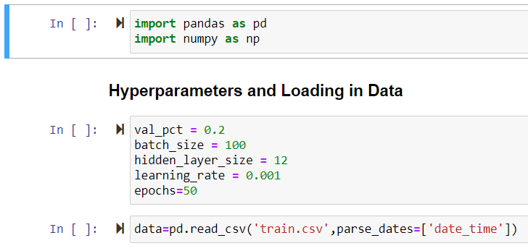
Hyperparameters and Loading in Data

Slide 4
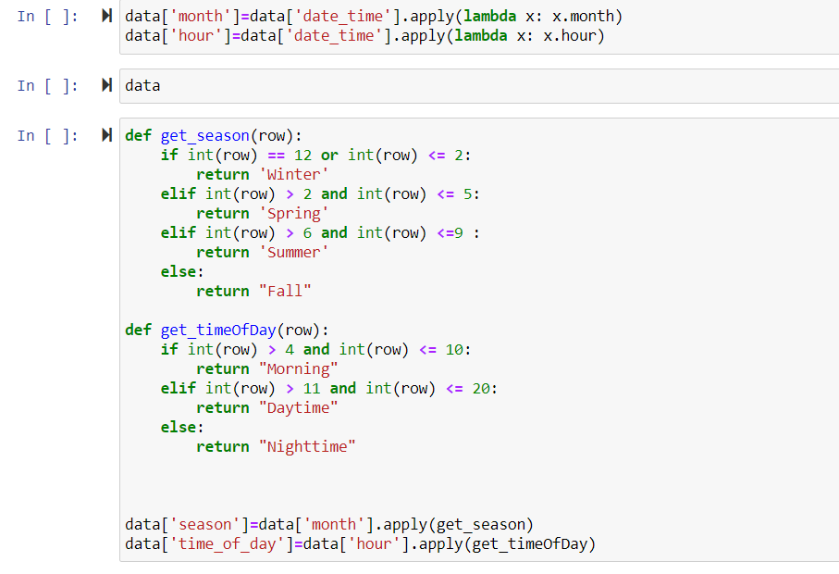
Feature Engineering

Slide 5
Preprocessing

Slide 6
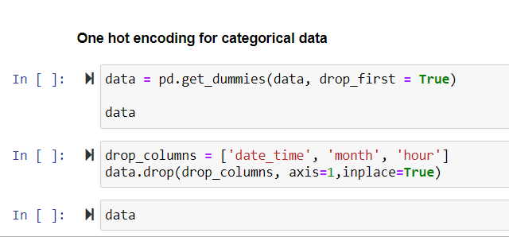
One-hot encoding/Multicollinearity

Slide 7
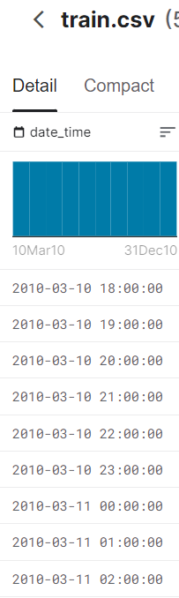
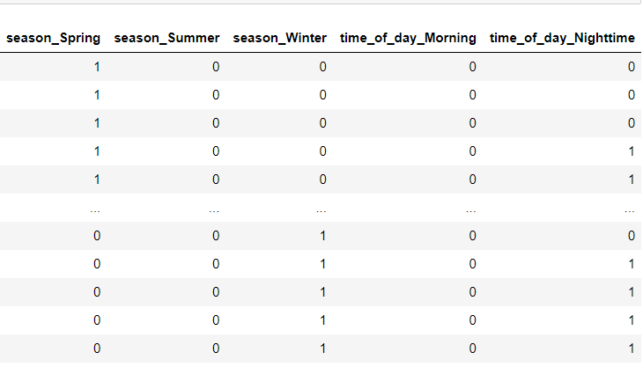
→

Slide 8
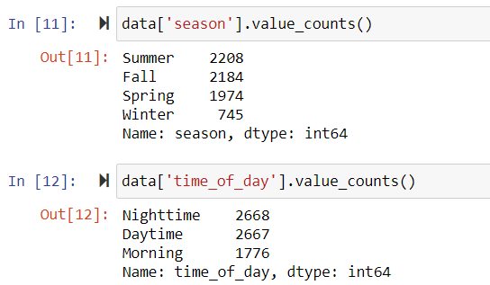
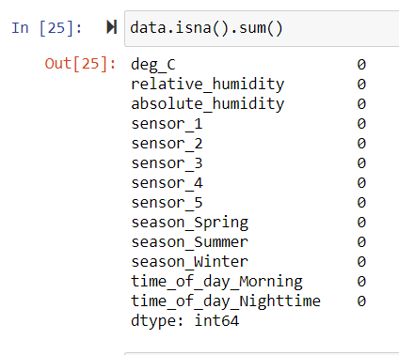
New Variables Sanity Check
Seasons : Dataset goes from 3/10/10 to 12/31/10
Time of Day: Slightly uneven divide for three manufactured categories (6/9/9 split)
Enough data points in each category for model to be viable
0 null values means new variables were made effectively

Slide 9
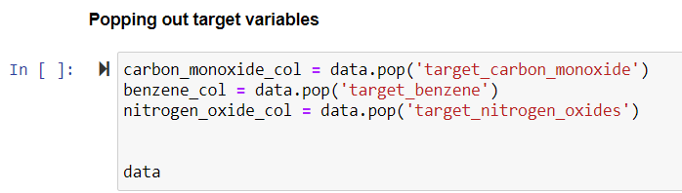
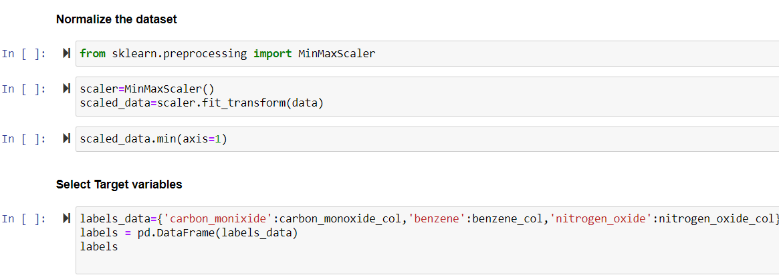

Slide 10
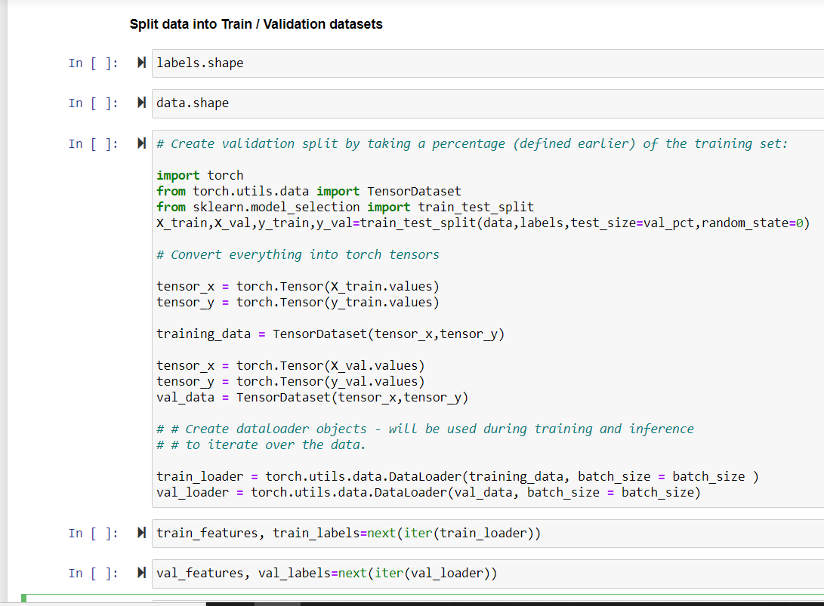
Train/Validation Splits

Slide 11
Building/Training Model

Slide 12
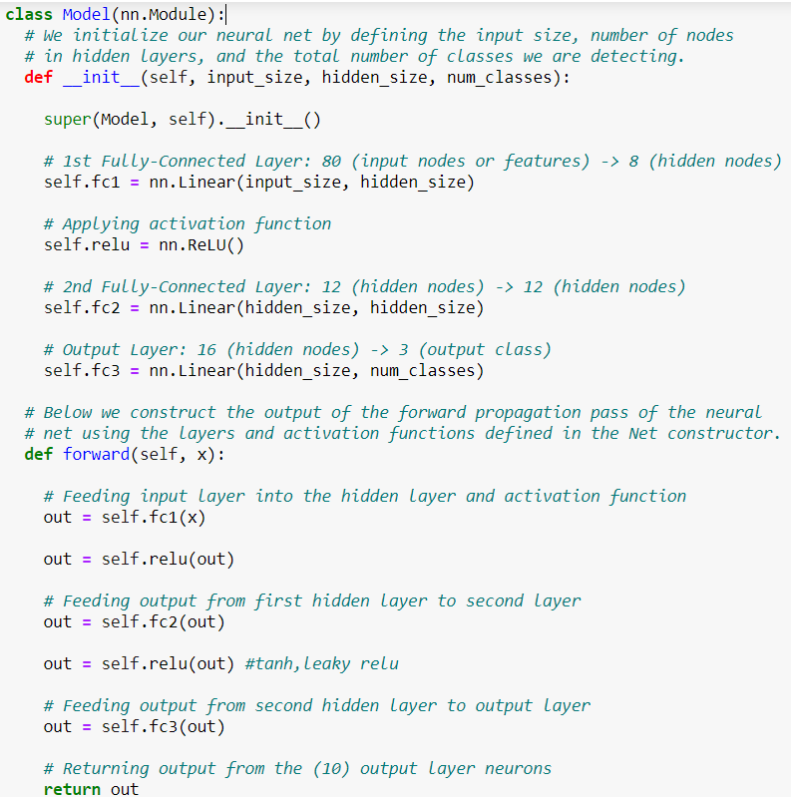

Slide 13
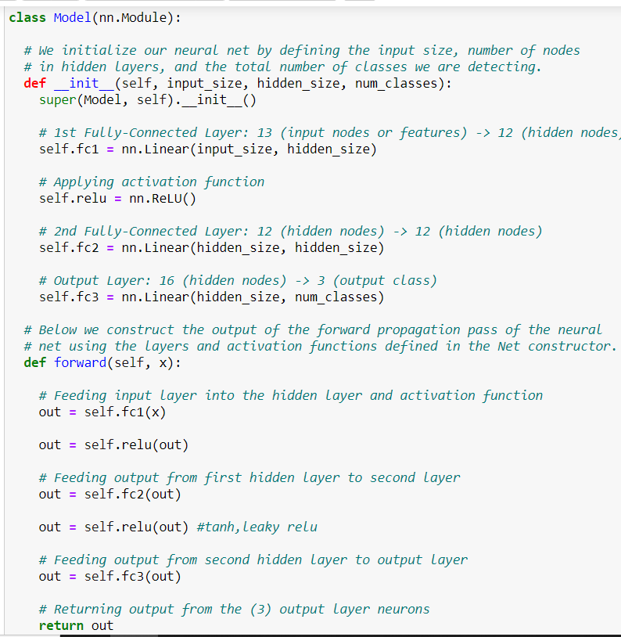

Slide 14
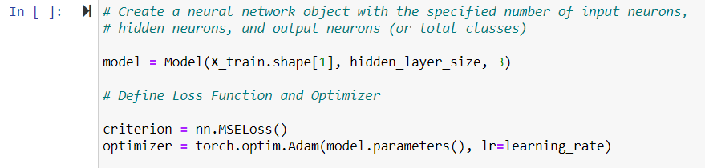

Slide 15
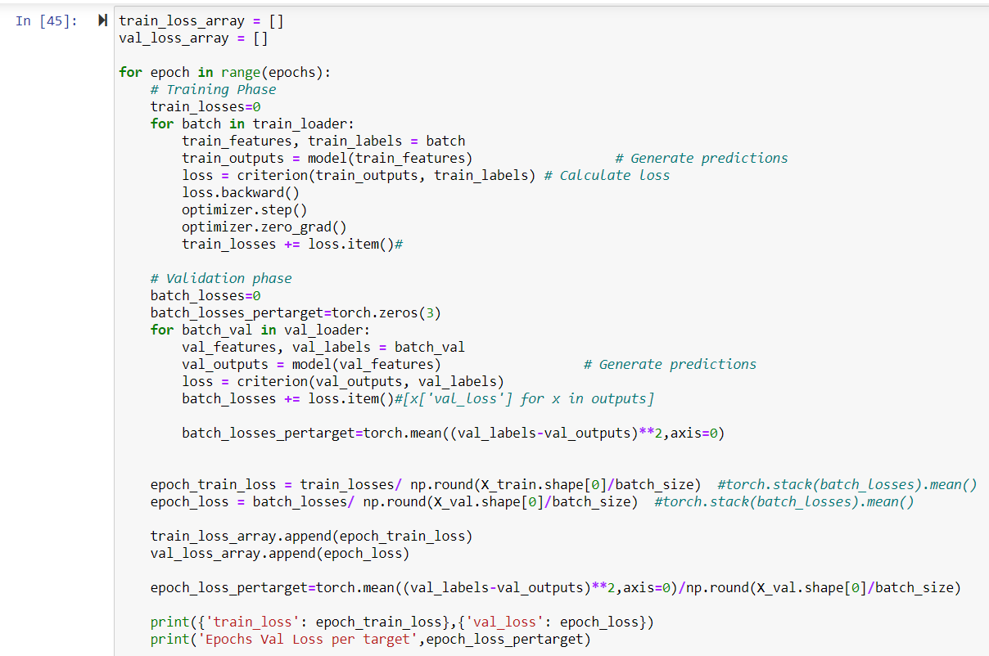

Slide 16
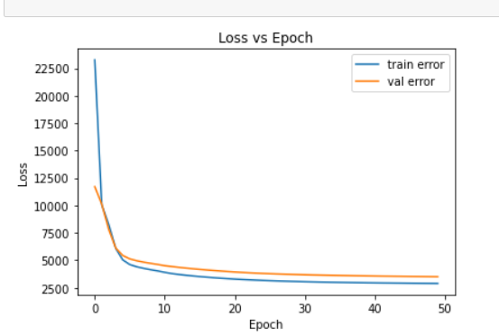
Loss Graph

Slide 17
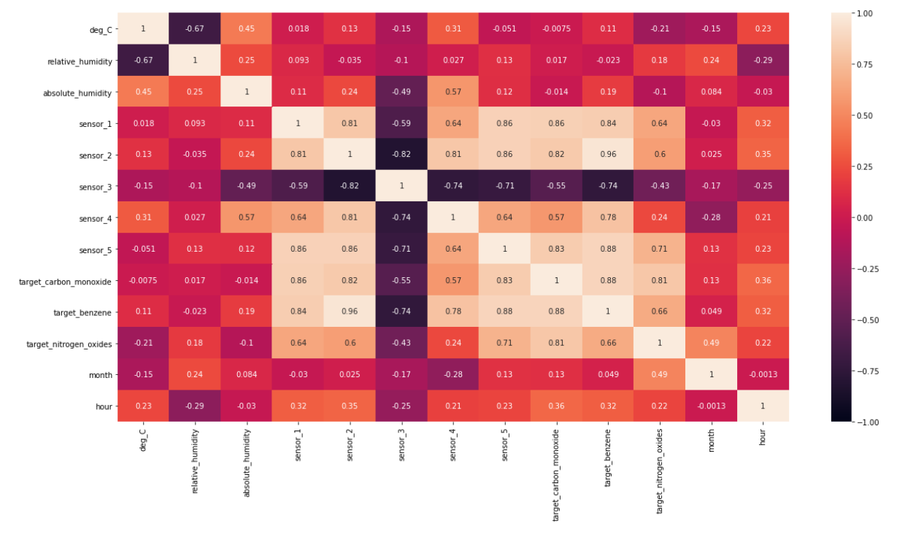
Correlation Heatmap

